Slide 1
COVID-19 World Vaccination Data Analysis
Tool: Excel Dashboard
By : Neeraj Sharma

Slide 2
TABLE OF CONTENTS
01
02
About Dataset
Problem statements
03
04
Charts used in Dashboard
Result
All about dataset used to analysis.
What questions this analysis will answers!!
All the charts used in excel dashboard.
Final Look of dashboard

Slide 3
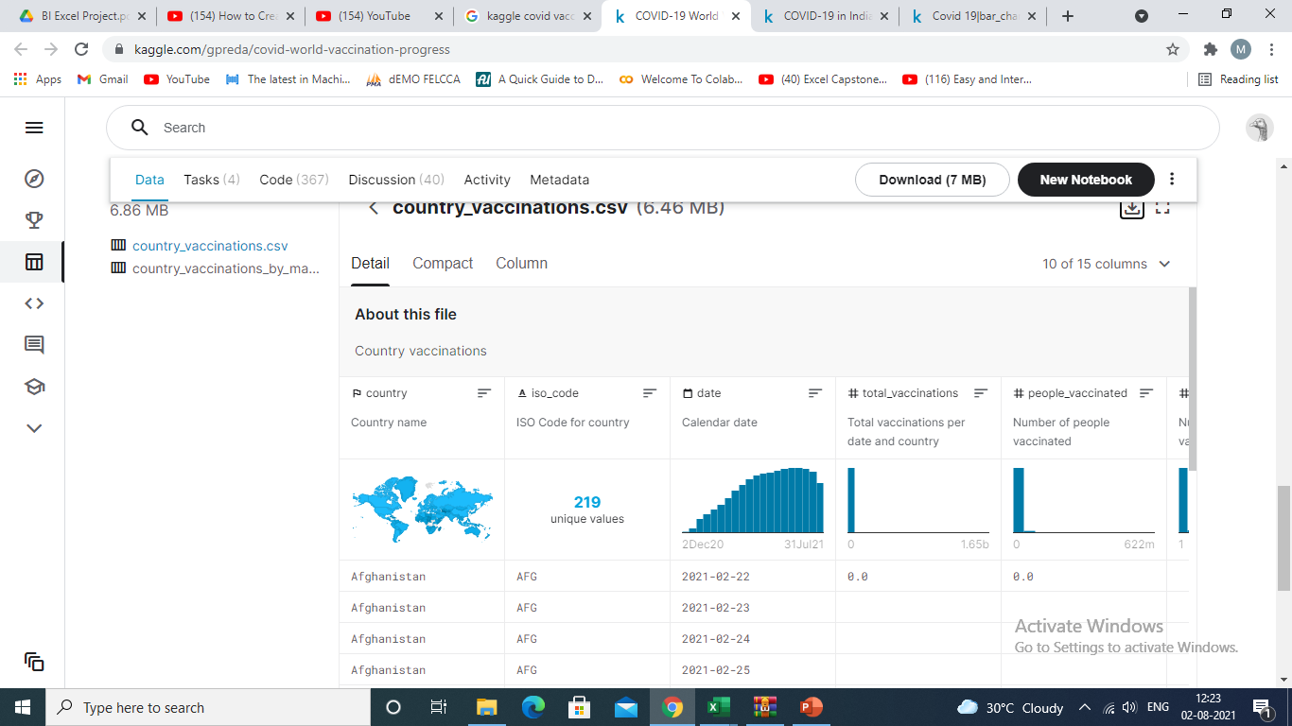
Dataset
01
Data is taken from Kaggle.
Country level vaccination data is gathered and assembled in one single file. Then, this data file is merged with locations data file to include vaccination sources information.
Data Length is 34464 and 19 columns.
Link to dataset: https://www.kaggle.com/gpreda/covid-world-vaccination-progress

Slide 4
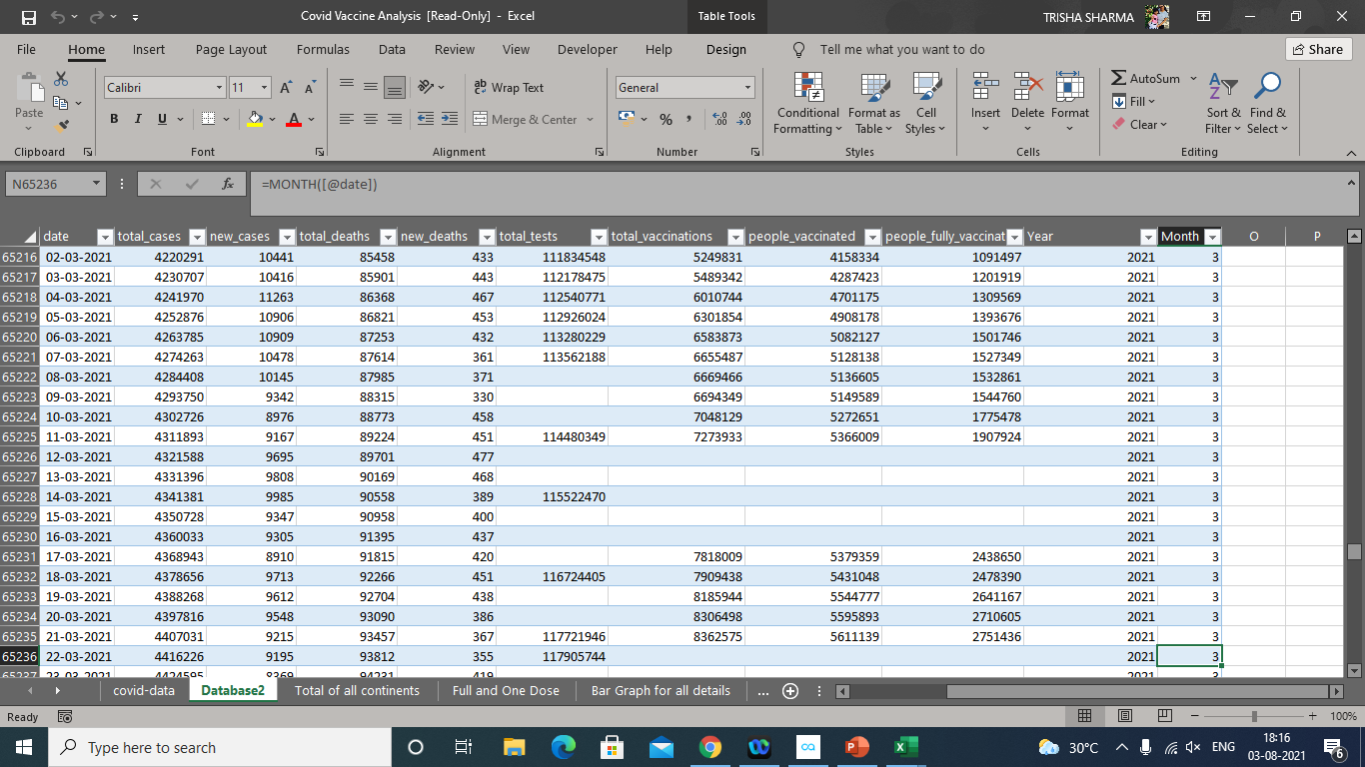

Slide 5
Problem Statements This analysis will help to track COVID-19 vaccination in the World, answer instantly to below questions!! 1. Tracking Coronavirus Vaccinations Around the World? 2. In depth study of total Number of people fully and partially vaccinated? 3. Analysis of total deaths and new deaths due to covid 19 around world month wise summery? 4. In which month Covid case was on peak in year 2020 and 2021?? 4. Which vaccine is maximum used in particular country? 5. What are the Top 10 Vaccine around world? 6. Asia continents covid 19 analysis ?
02

Slide 6
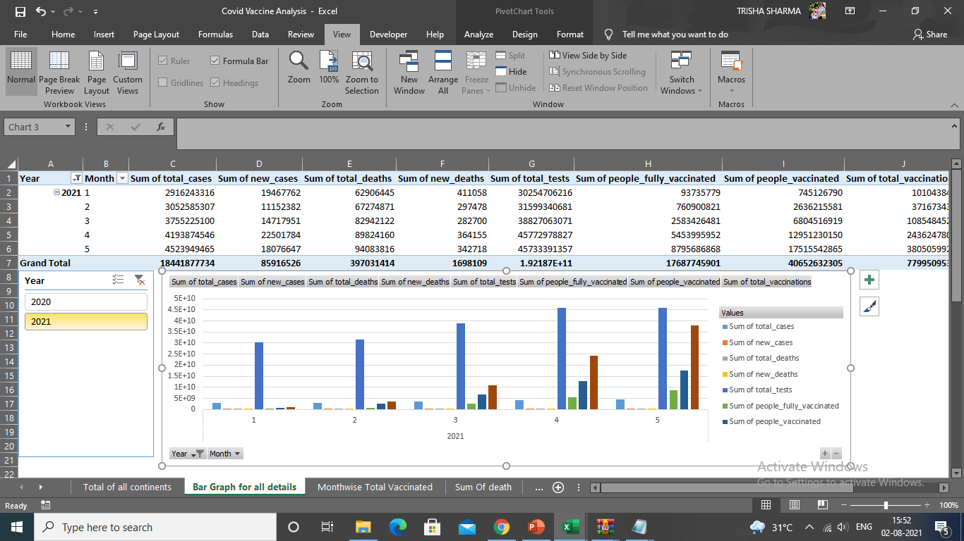
Background Work:

Slide 7
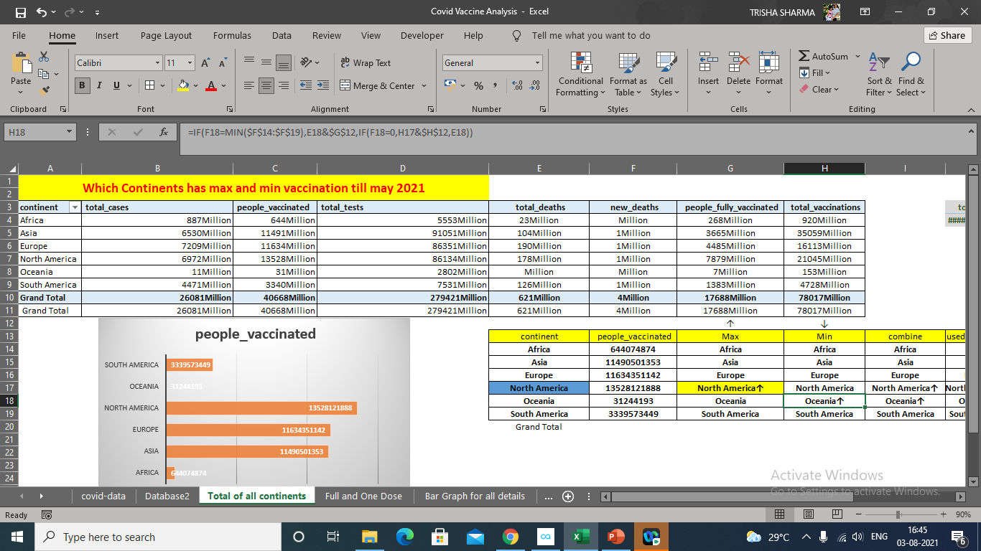
Cont.

Slide 8
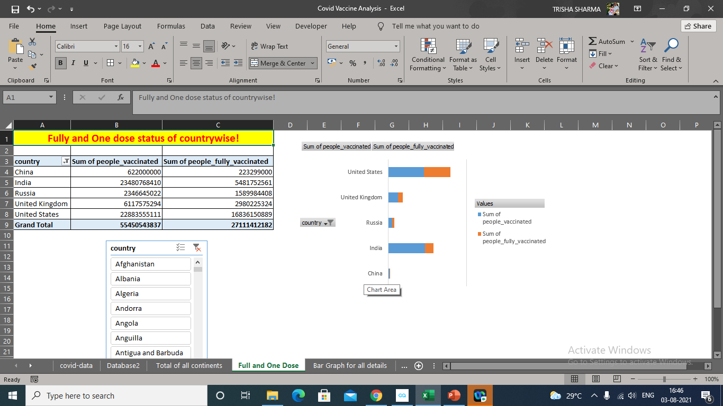
Cont.

Slide 9
Comparison of vaccination drive in continents
Month wise

Slide 10
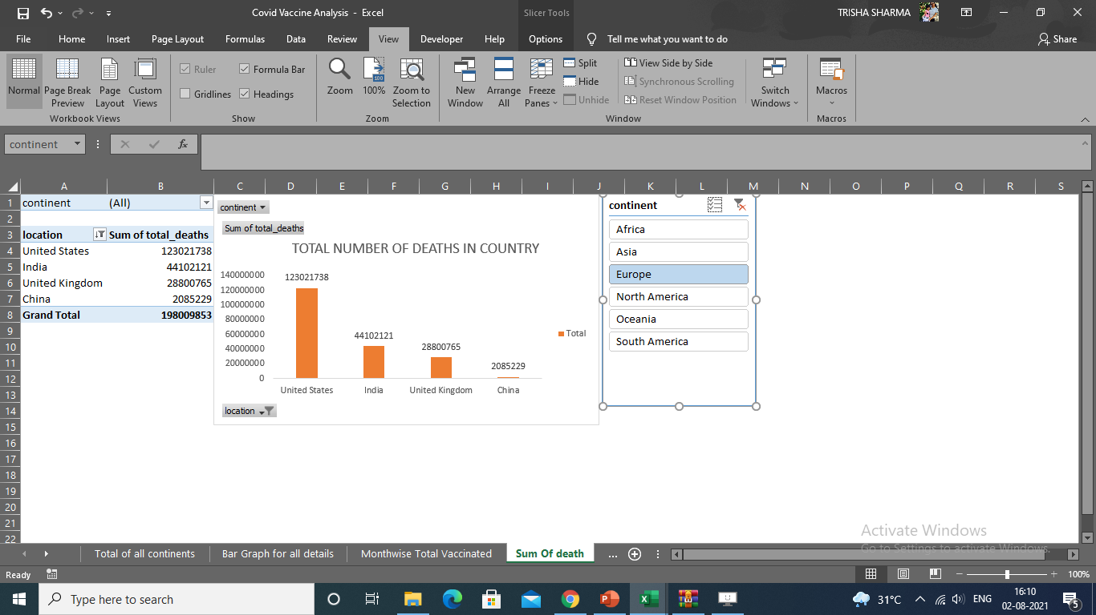
Bar chart
Country which suffered most

Slide 11
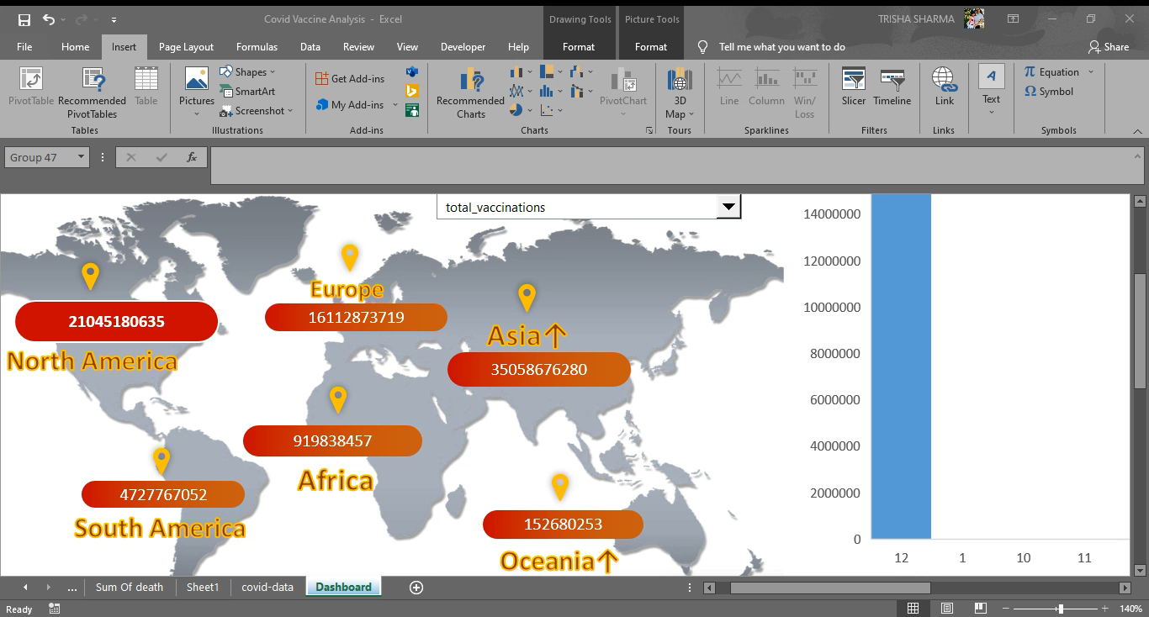
Dynamic Display of Total Vaccinations, Sum of Full And Partial Vaccines along with number deaths in continents:

Slide 12
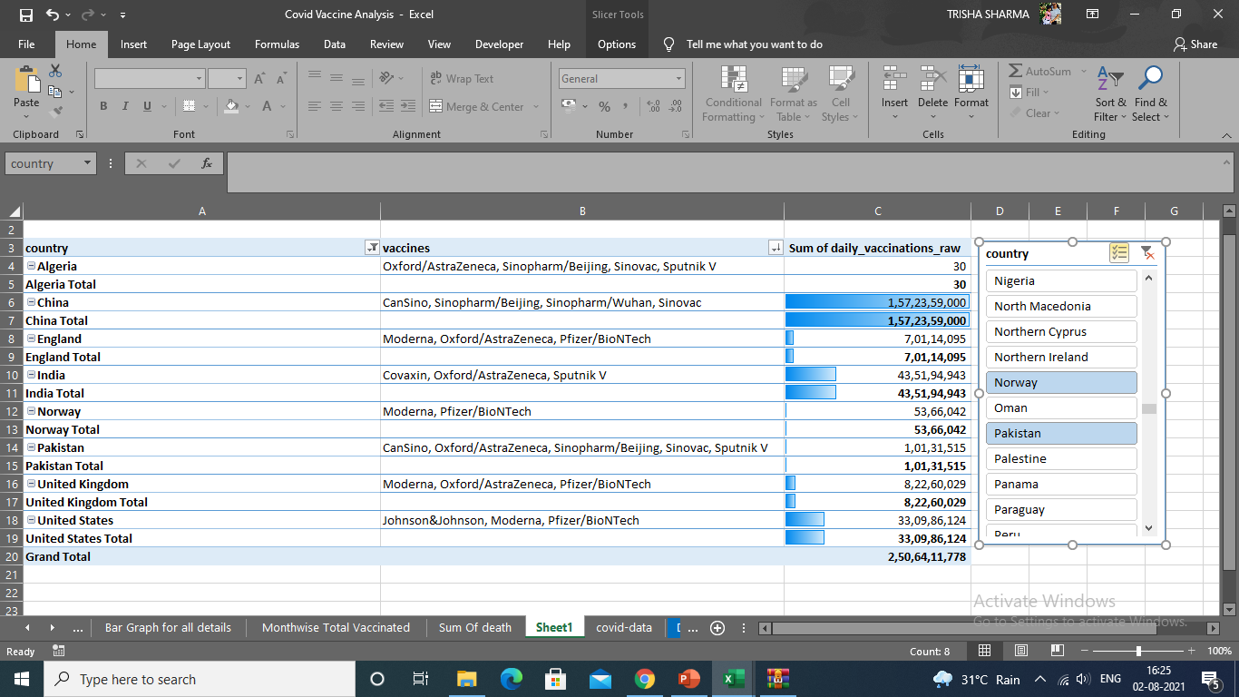
Records of daily vaccination with vaccines name

Slide 13

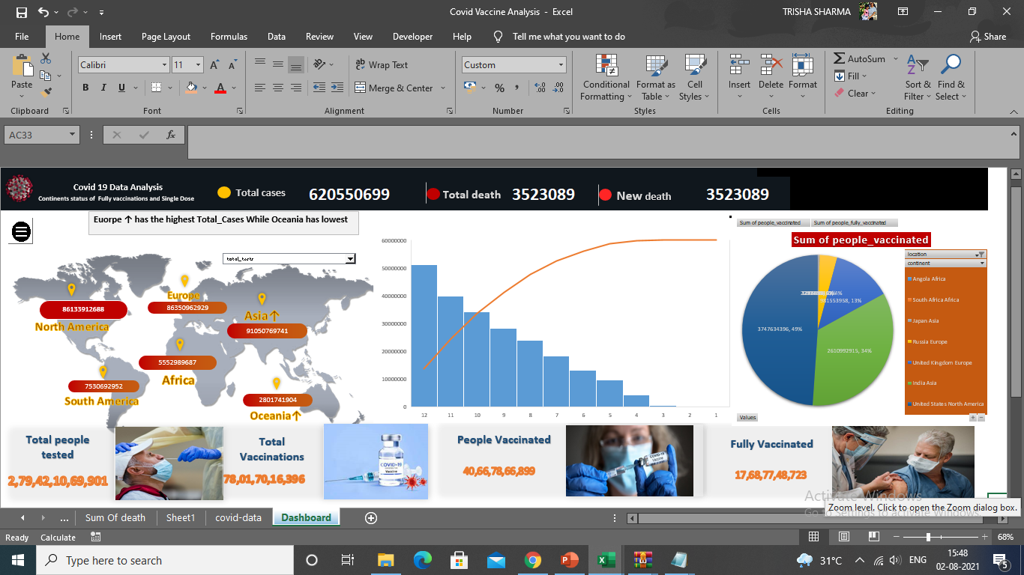
A PICTURE IS WORTH A THOUSAND WORDS

Slide 14
Conclusion
Total 26081 Millon Covid 19 Cases found all over world.
We found that U.S has maximum death due to Covid 19,Brazil at second then India.
Oxford–AstraZeneca vaccine is most used covid vaccine,where Modems at number second.
U.S has maximum people has first dose and fully vaccinated from covid 19.
5. In month of May 2021 Covid 19 cases was higher than
other months.

Slide 15


Thanks
Link to File and Video
Link to YouTube Video
https://youtu.be/FqtX_zcznTE
Google Drive Link
https://drive.google.com/file/d/1pGkZIhjCKzNab1Ulnme1AK0dqmn3AWCH/view?usp=sharing

